Slide 1
Decision Tree

Slide 2
A programming task

Slide 3
Classification Learning: Definition
Given a collection of records (training set)
Each record contains a set of attributes, one of the attributes is the class
Find a model for the class attribute as a function of the values of the other attributes
Goal: previously unseen records should be assigned a class as accurately as possible
Use test set to estimate the accuracy of the model
Often, the given data set is divided into training and test sets, with training set used to build the model and test set used to validate it

Slide 4
Classification
Classification is a most familiar and most popular data mining technique.
Classification applications includes image and pattern recognition, loan approval, detecting faults in industrial applications.
All approaches to performing classification assumes some knowledge of the data.
Training set is used to develop specific parameters required by the technique.

Slide 5
Classification Learning Techniques
Decision tree-based methods
Rule-based methods
Instance-based methods
Probability-based methods
Neural networks
Support vector machines
Logic-based methods

Slide 6
Decision tree
A decision tree takes as input an object or situation described by a set of attributes and returns a "decision” the predicted output value for the input.
A decision tree is a tree where each node represents a feature(attribute), each link(branch) represents a decision(rule) and each leaf represents an outcome(categorical or continues value).
A decision tree is a natural and simple way of inducing following kind of rules.
If (Age is x) and (income is y) and (family size is z) and (credit card spending is p) then he will accept the loan
 It is powerful and perhaps most widely used modeling technique of all

Slide 7
Why decision tree?
Decision trees are powerful and popular tools for classification and prediction.
Decision trees represent rules, which can be understood by humans and used in knowledge system such as database.

Slide 8
key requirements
Attribute-value description: object or case must be expressible in terms of a fixed collection of properties or attributes (e.g., hot, mild, cold).
Predefined classes (target values): the target function has discrete output values (bolean or multiclass)
Sufficient data: enough training cases should be provided to learn the model.

Slide 9
Decision tree
A decision tree reaches its decision by performing a sequence of tests.
Tree where the root and each internal node is labeled with a question.
The arcs represent each possible answer to the associated question.
Each leaf node represents a prediction of a solution to the problem.
Populer technique for classification; Leaf node indicates class to which the corresponding tuple belongs.

Slide 10
Decision Tree Representation
Each internal node tests an attribute
Each branch corresponds to attribute value
Each leaf node assigns a classification

Slide 11
Decision Tree for PlayTennis
Outlook
Sunny
Overcast
Rain
Humidity
Each internal node tests an attribute
High
Normal
Each branch corresponds to an
attribute value node
No
Yes
Each leaf node assigns a classification

Slide 12
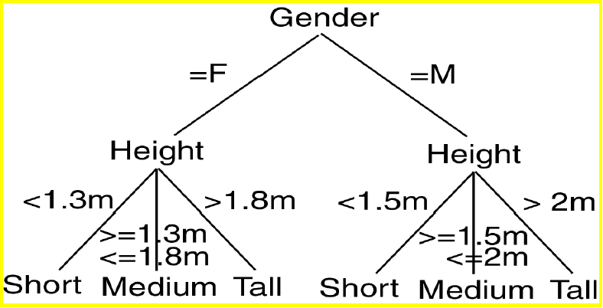
Decision tree

Slide 13
Decision Tree Model
A Decision Tree Model is a computational model consisting of three parts:
Decision Tree
Algorithm to create the tree
Algorithm that applies the tree to data
• Creation of the tree is the most difficult part.
• Processing is basically a search similar to that in a binary search tree (although DT may not be binary).

Slide 14
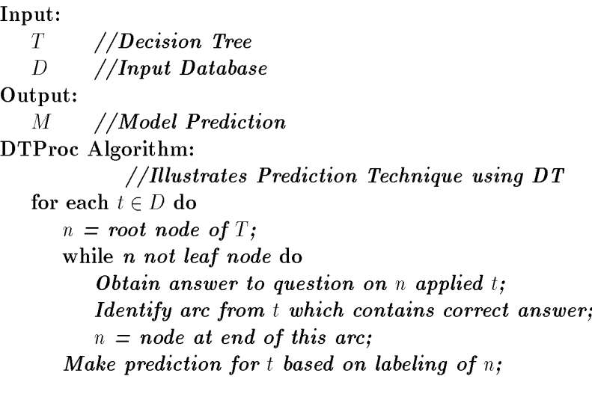
Decision Tree Algorithm

Slide 15
Decision Tree Algorithm
The decision tree approach is most useful in classification problems. With this technique, a tree is constructed to model the classification process.
Once the tree is build, it is applied to each tuple in the database and results in a classification for that tuple.
There are two basics step in this techinque: Building the tree and Applying the tree to the database.

Slide 16
Decision Tree Algorithm
The decision tree approach to classification is to divide the search space into rectangular region.
A tuple is classified based on the region into which it falls.
Definition: Given a database D={t1……..tn} where ti=<ti1……..tih> and the database schema consist of following attributes {A1,A2,………,Ah}valso a set of classes C={C1,……,Cm}. A decision
tree DT or classification tree is a tree associated with D that has the following properties:
Each internal node is labeled with an attribute Ai
Each arc is labeled with a predicate that can be applied to a attribute associated with a parent.
Each leaf node is labeled with a class Cj.

Slide 17
Built Decision Tree Algorithm
Algorithm BuiltDT
Input: D : Training data set
Output: T : Decision tree
Steps
If all tuples in D belongs to the same class C_{j}
Add a leaf node labeled as C_{j}
Return // Termination condition
Select an attribute A_{i} (so that it is not selected twice in the same branch)
Partition D = { D₁, D₂, …, D_{p}} based on p different values of A_{i} in D
For each D_{k} ϵ D
Create a node and add an edge between D and D_{k} with label as the A_{i}’s attribute value in D_{k}
For each D_{k} ϵ D
BuildTD(D_{k}) // Recursive call
Stop

Slide 18
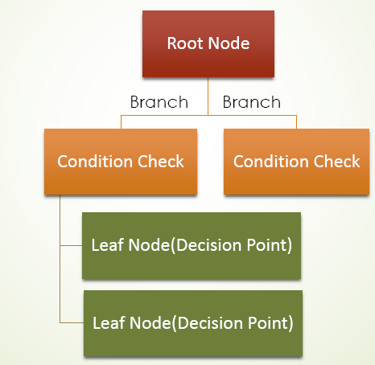
DECISION TREE TERMS

Slide 19
Example of a Decision Tree
categorical
categorical
continuous
class
Splitting Attributes
Refund
Yes
No
NO
MarSt
Single, Divorced
Married
TaxInc
NO
< 80K
> 80K
NO
YES
Training Data
Model: Decision Tree

Slide 20
Another Example of Decision Tree
categorical
categorical
continuous
class
MarSt
Single, Divorced
Married
NO
Refund
Yes
No
NO
TaxInc
< 80K
> 80K
NO
YES
There could be more than one tree that fits the same data!

Slide 21
Decision Tree Classification Task
Decision Tree

Slide 22
Apply Model to Test Data
Test Data
Start from the root of tree.
Refund
Yes
No
NO
MarSt
Single, Divorced
Married
TaxInc
NO
< 80K
> 80K
NO
YES

Slide 23
Apply Model to Test Data
Test Data
Refund
Yes
No
NO
MarSt
Single, Divorced
Married
TaxInc
NO
< 80K
> 80K
NO
YES

Slide 24
Apply Model to Test Data
Test Data
Refund
Yes
No
NO
MarSt
Single, Divorced
Married
TaxInc
NO
< 80K
> 80K
NO
YES

Slide 25
Apply Model to Test Data
Test Data
Refund
Yes
No
NO
MarSt
Single, Divorced
Married
TaxInc
NO
< 80K
> 80K
NO
YES

Slide 26
Apply Model to Test Data
Test Data
Refund
Yes
No
NO
MarSt
Single, Divorced
Married
TaxInc
NO
< 80K
> 80K
NO
YES

Slide 27
Apply Model to Test Data
Test Data
Refund
Yes
No
NO
MarSt
Single, Divorced
Married
Assign Cheat to “No”
TaxInc
NO
< 80K
> 80K
NO
YES

Slide 28
Decision Tree Classification Task
Decision Tree

Slide 29
EASY EXAMPLE
Joe’s garage is considering hiring another mechanic.
The mechanic would cost them an additional $50,000 / year in salary and benefits.
If there are a lot of accidents in Iowa City this year, they anticipate making an additional $75,000 in net revenue.
If there are not a lot of accidents, they could lose $20,000 off of last year’s total net revenues.
Because of all the ice on the roads, Joe thinks that there will be a 70% chance of “a lot of accidents” and a 30% chance of “fewer accidents”
Assume if he doesn’t expand he will have the same revenue as last year.

Slide 30
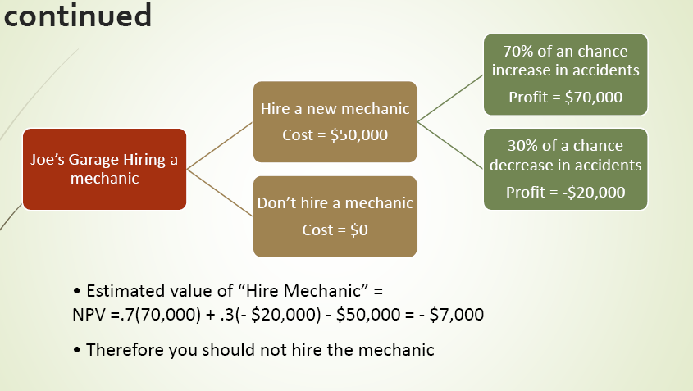
EASY EXAMPLE

Slide 31
Example
You want to guess the outcome of next week's game between the MallRats and the Chinooks.
Available knowledge / Attribute
was the game at Home or Away
was the starting time 5pm, 7pm or 9pm.
Did Joe play center, or forward.
whether that opponent's center was tall or not.
…..

Slide 32
Basket ball data

Slide 33
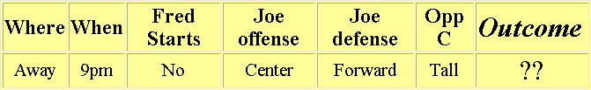
What we know
The game will be away, at 9pm, and that Joe will play center on offense…
A classification problem
Generalizing the learned rule to new examples

Slide 34
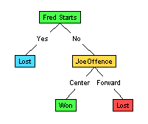
Illustration
(1) Which to start? (root)
(2) Which node to proceed?
(3) When to stop/ come to conclusion?

Slide 35
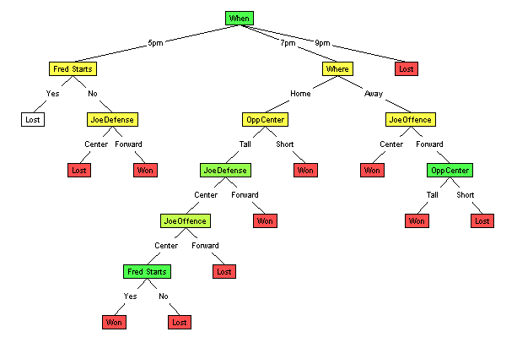
Random split
The tree can grow huge
These trees are hard to understand.
Larger trees are typically less accurate than smaller trees.

Slide 36
Principled Criterion
Selection of an attribute to test at each node - choosing the most useful attribute for classifying examples.
information gain
measures how well a given attribute separates the training examples according to their target classification
This measure is used to select among the candidate attributes at each step while growing the tree

Slide 37
How to build This Decision Tree?
There are couple of algorithms there to build a decision tree , we only talk about a few which are
ID3 (Iterative Dichotomiser 3) → uses Entropy function and Information gain as metrics.
CART (Classification and Regression Trees) → uses Gini Index(Classification) as metric.

Slide 38
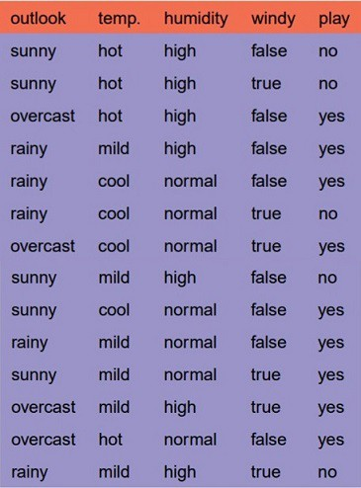
Classification with using the ID3 algorithm.
Let’s just take a famous dataset in the machine learning world which is weather dataset(playing game Y or N based on weather condition).
We have four X values (outlook,temp,humidity and windy) being categorical and one y value (play Y or N).
so we need to learn the mapping between X and y.
This is a binary classification problem, lets build the tree using the ID3 algorithm
To create a tree, we need to have a root node first and we know that nodes are features/ attributes (outlook,temp,humidity and windy),

Slide 39
Splitting Based on Ordinal Attributes
Multi-way split: Use as many partitions as distinct values.
Binary split: Divides values into two subsets. Need to find optimal partitioning.
What about this split?
Size
Small
Large
Medium
Size
Size
{Small, Medium}
OR
{Medium, Large}
{Large}
{Small}
Size
{Small, Large}
{Medium}

Slide 40
Splitting Based on Continuous Attributes

Slide 41
How to determine the Best Split
Greedy approach:
Nodes with homogeneous class distribution are preferred
Need a measure of node impurity:
Non-homogeneous,
High degree of impurity
Homogeneous,
Low degree of impurity

Slide 42
So which one do we need to pick first??
Determine the attribute that best classifies the training data;
Use this attribute at the root of the tree. Repeat this process at for each branch
This means we are performing top-down, greedy search through the space of possible decision trees.

Slide 43
okay so how do we choose the best
attribute?
Use the attribute with the highest information gain in ID3
In order to define information gain precisely,
We begin by defining a measure commonly used in information theory, called entropy
Characterizes the (im)purity of an arbitrary collection of examples.”

Slide 44
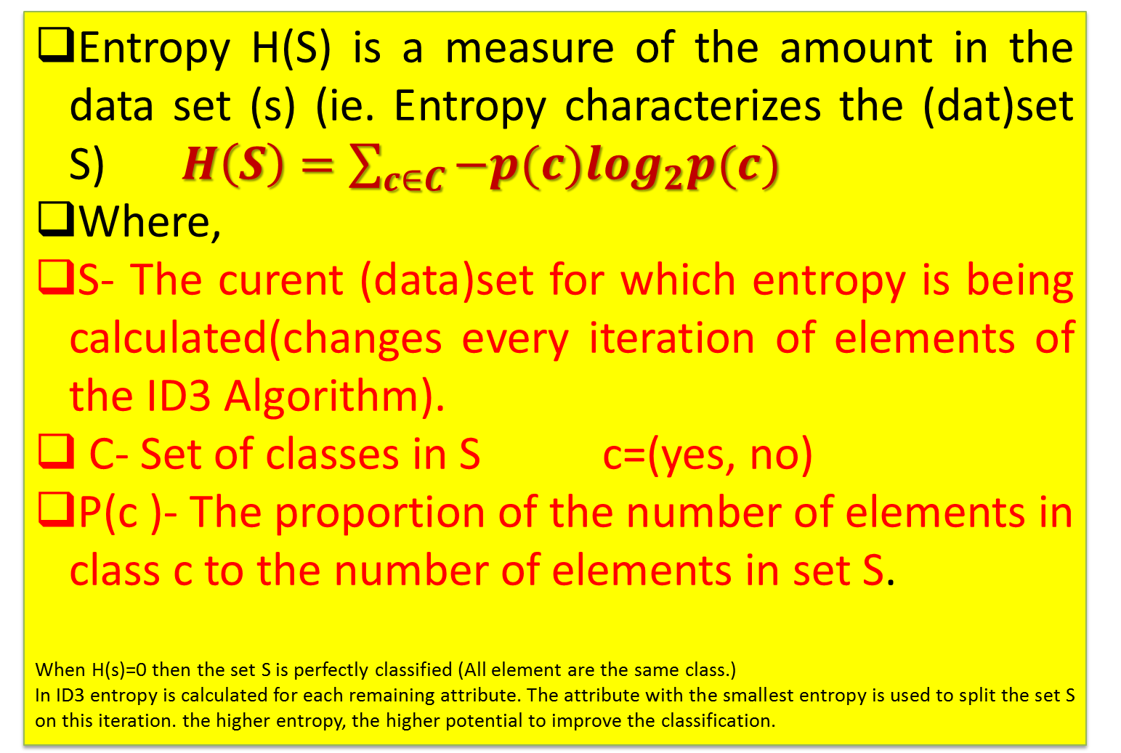
Entropy
Entropy H(S) is a measure of the amount in the data set (s) (ie. Entropy characterizes the (dat)set S)$H\left(S\right)=\sum_{c∈C}{−p(c)\log_{2}p(c)}$
Where,
S- The curent (data)set for which entropy is being calculated(changes every iteration of elements of the ID3 Algorithm).
C- Set of classes in S c=(yes, no)
P(c )- The proportion of the number of elements in class c to the number of elements in set S.
When H(s)=0 then the set S is perfectly classified (All element are the same class.)
In ID3 entropy is calculated for each remaining attribute. The attribute with the smallest entropy is used to split the set S on this iteration. the higher entropy, the higher potential to improve the classification.

Slide 45
Entropy (as information)
Entropy at a given node t:
(where p( j | t) is the relative frequency of class j at node t)
Based on Shannon’s information theory
For simplicity, assume only 2 classes Yes and No
Assume t is a set of messages sent to a receiver that must guess their class
If p( Yes | t )=1 (resp., p( No | t )=1), then the receiver guesses a new example as Yes (resp., No). No message need be sent.
If p( Yes | t )=p( No | t )=0.5, then the receiver cannot guess and must be told the class of a new example. A 1-bit message must be sent.
If 0<p( Yes | t )<1, then the receiver needs less than 1 bit on average to know the class of a new example.

Slide 46
Entropy (as homogeneity)
Think chemistry/physics
Entropy is measure of disorder or homogeneity
Minimum (0.0) when homogeneous / perfect order
Maximum (1.0, in general log C) when most heterogeneous / complete chaos
In ID3
Minimum (0.0) when all records belong to one class, implying most information
Maximum (log C) when records are equally distributed among all classes, implying least information
Intuitively, the smaller the entropy the purer the partition

Slide 47
Entropy
For a binary classification problem
If all examples are positive or all are negative then entropy will be zero i.e, low.
If half of the examples are of positive class and half are of negative class then entropy is one i.e, high.

Slide 48
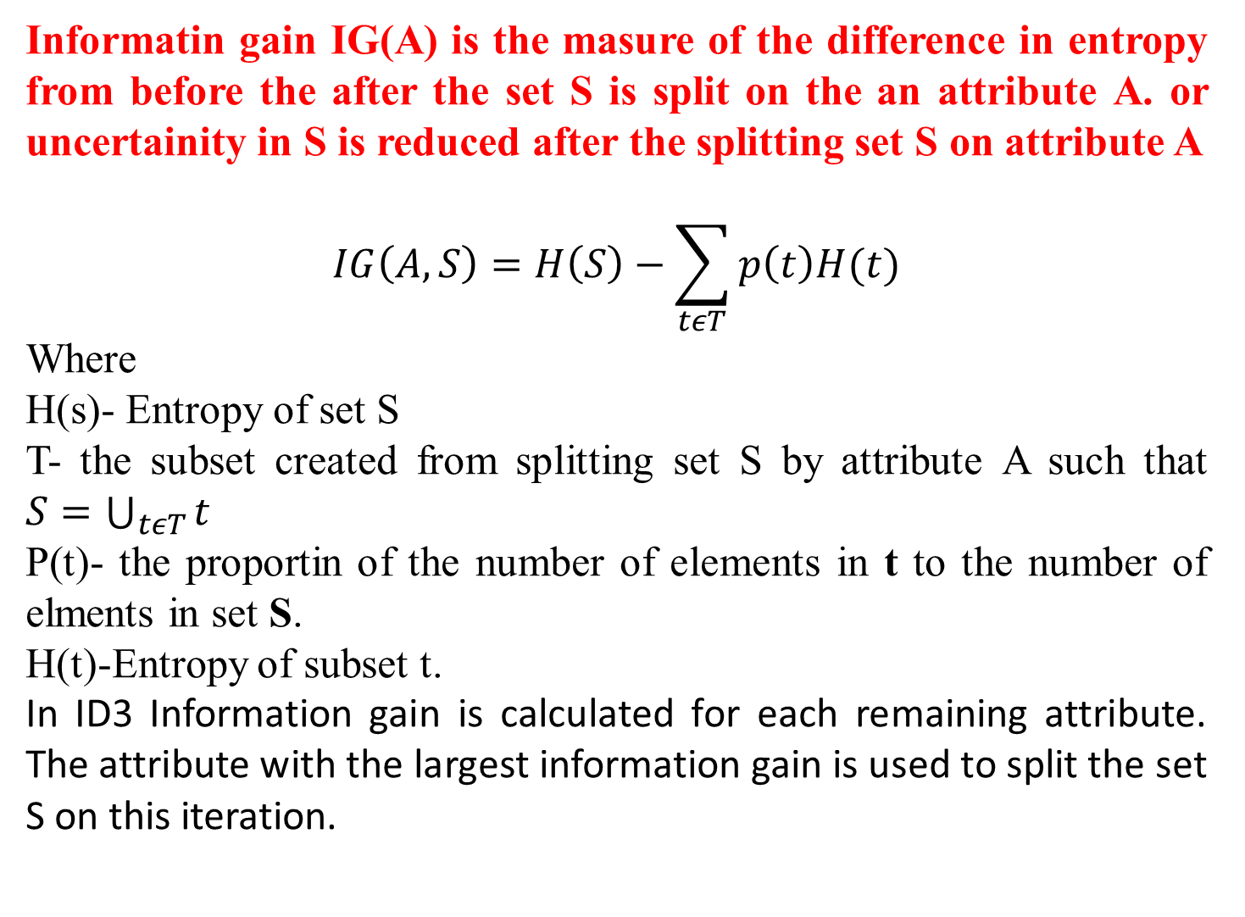
Information Gain
Informatin gain IG(A) is the masure of the difference in entropy from before the after the set S is split on the an attribute A. or uncertainity in S is reduced after the splitting set S on attribute A
$$IG\left(A,S\right)=H\left(S\right)−\sum_{tεT}{p\left(t\right)H(t)}$$
Where
H(s)- Entropy of set S
T- the subset created from splitting set S by attribute A such that $S=\bigcup_{tεT}{t}$
P(t)- the proportin of the number of elements in t to the number of elments in set S.
H(t)-Entropy of subset t.
In ID3 Information gain is calculated for each remaining attribute. The attribute with the largest information gain is used to split the set S on this iteration.

Slide 49
Information Gain
Information Gain:
(where parent Node, p is split into k partitions, and
n_{i} is number of records in partition i)
Measures reduction in entropy achieved because of the split ➔ maximize
ID3 chooses to split on the attribute that results in the largest reduction, i.e, (maximizes GAIN)
Disadvantage: Tends to prefer splits that result in large number of partitions, each being small but pure.

Slide 50
Information Gain
Okay lets apply these metrics to our dataset to split the data(getting the root node) Steps:
1.Compute the entropy for data-set
2.for every attribute/feature: 1.calculate entropy for all categorical values 2.take average information entropy for the current attribute 3.calculate gain for the current attribute
3. Pick the highest gain attribute. 4. Repeat until we get the tree we desired.

Slide 51
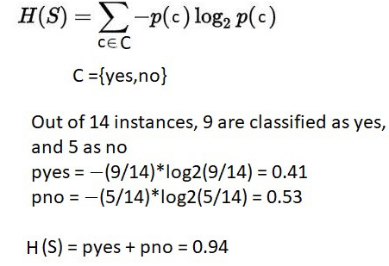
Compute the entropy for the weather data set:

Slide 52
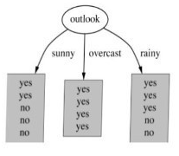
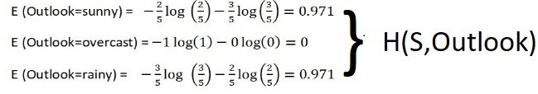
Compute the entropy for the weather data set:

Slide 53
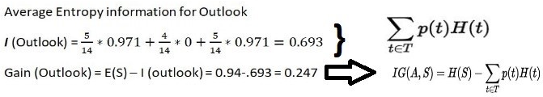
Compute the entropy for the weather data set:

Slide 54
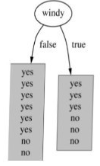
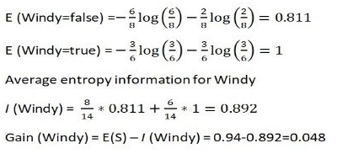
Compute the entropy for the weather data set:
Similarity we can calculate for other two attributes(Humidity and Temp).

Slide 55
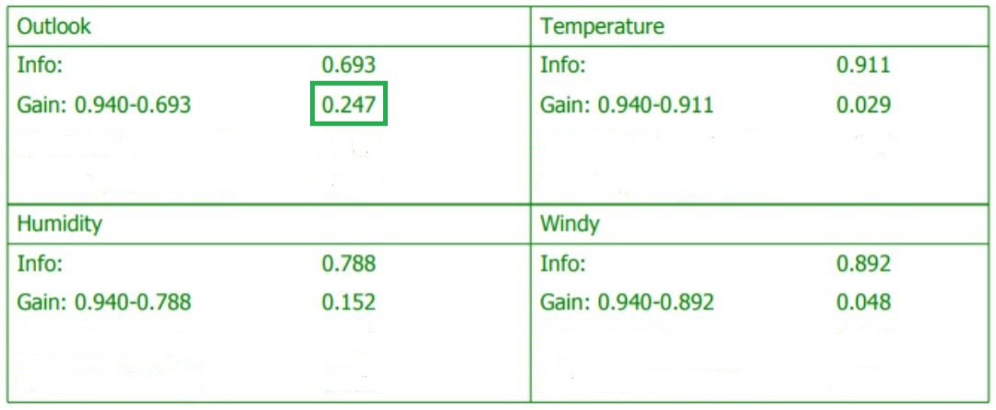
Pick the highest gain attribute.

Slide 56
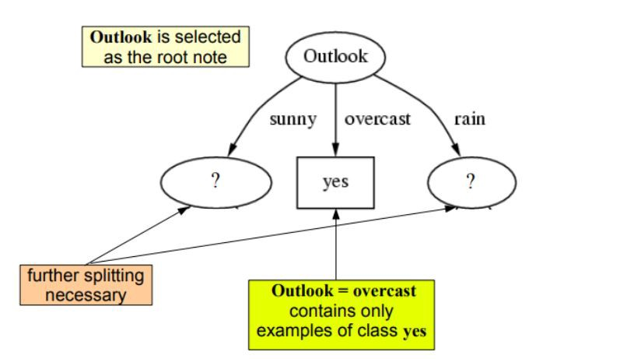
So our root node is Outlook.

Slide 57
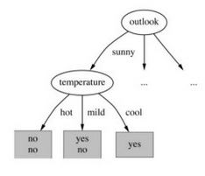
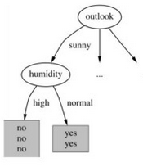
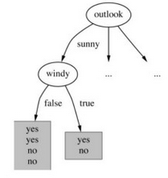
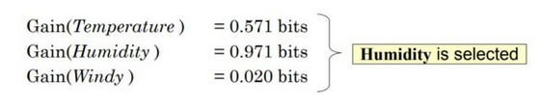
Repeat the same thing for sub-trees till we get the tree.

Slide 58
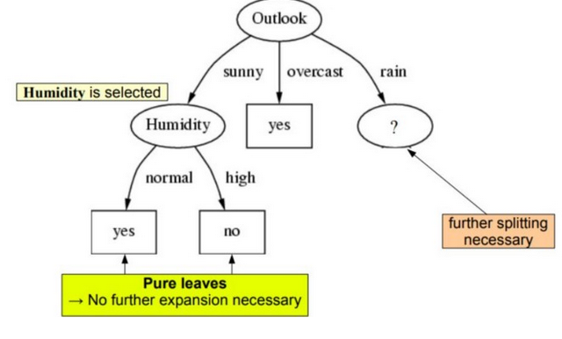
Repeat the same thing for sub-trees till we get the tree.
Finally we get the tree something like his.

Slide 59
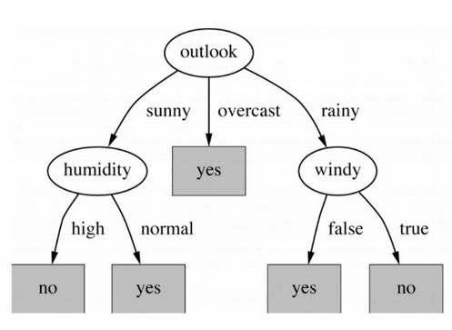
Finale Decision tree

Slide 60
Entropy of a Training Set
Example 9.10: OPTH dataset
Consider the OTPH data shown in the following table with total 24 instances in it.
Age | Eye sight | Astigmatic | Use Type | Class
1 1 1 1 1 1 | 1 1 1 1 2 2 | 1 1 2 2 1 1 | 1 2 1 2 1 2 | 3 2 3 1 3 2
1 1 2 2 2 2 | 2 2 1 1 1 1 | 2 2 1 1 2 2 | 1 2 1 2 1 2 | 3 1 3 2 3 1
2 2 2 2 3 3 | 2 2 2 2 1 1 | 1 1 2 2 1 1 | 1 2 1 2 1 2 | 3 2 3 3 3 3
3 3 3 3 3 3 | 1 1 2 2 2 2 | 2 2 1 1 2 2 | 1 2 1 2 1 2 | 3 1 3 2 3 3
A coded forms for all values of attributes are used to avoid the cluttering in the table.

Slide 61
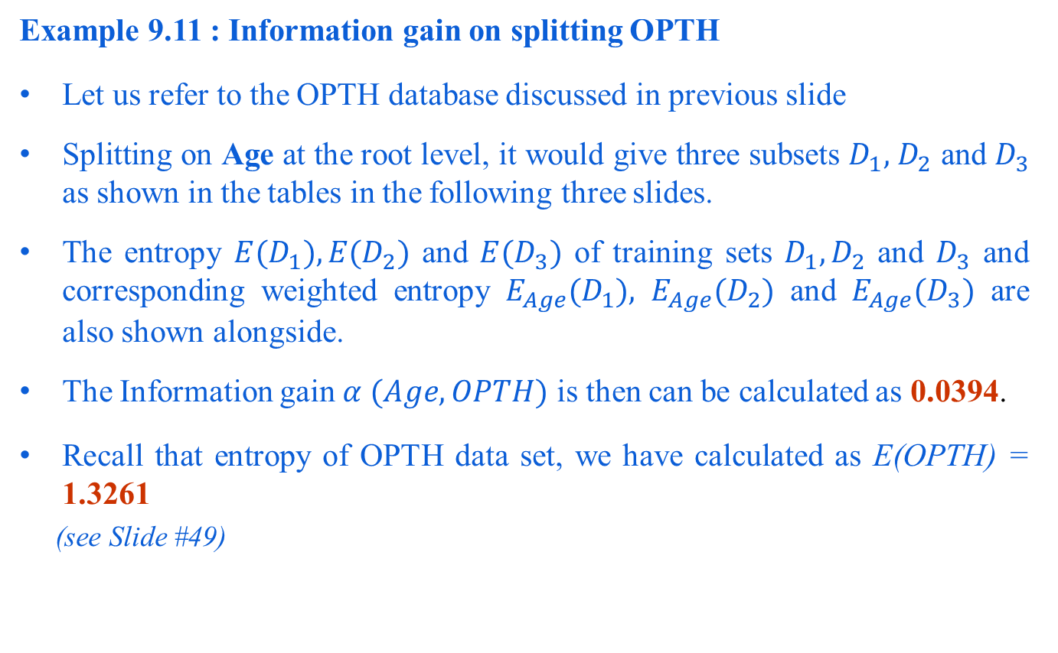
Information Gain Calculation
Example 9.11 : Information gain on splitting OPTH
Let us refer to the OPTH database discussed in previous slide
Splitting on Age at the root level, it would give three subsets $D_{1},{ D}_{2}$ and $D_{3}$ as shown in the tables in the following three slides.
The entropy ${E(D}_{1}),{E(D}_{2})$ and ${E(D}_{3})$ of training sets $D_{1},D_{2}$ and $D_{3}$ and corresponding weighted entropy $E_{Age}{(D}_{1}),$ $E_{Age}{(D}_{2})$ and $E_{Age}{(D}_{3})$ are also shown alongside.
The Information gain $α (Age, OPTH)$ is then can be calculated as 0.0394.
Recall that entropy of OPTH data set, we have calculated as E(OPTH) = 1.3261
(see Slide #49)

Slide 62
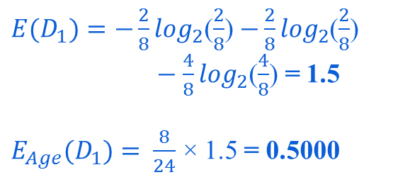
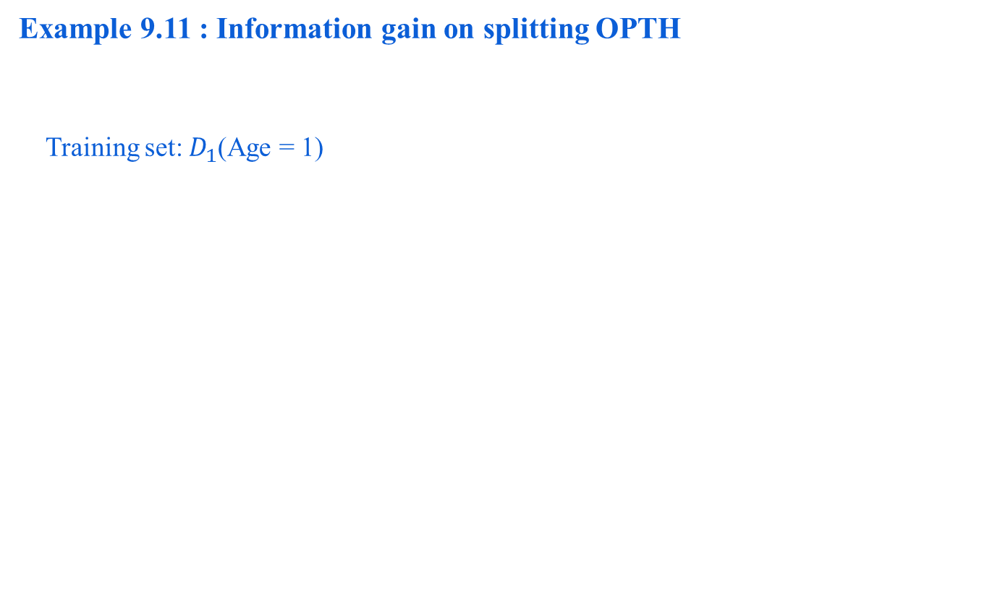
Information Gain Calculation
Example 9.11 : Information gain on splitting OPTH
Training set: $D_{1}$(Age = 1)
Age | Eye-sight | Astigmatism | Use type | Class
1 | 1 | 1 | 1 | 3
1 | 1 | 1 | 2 | 2
1 | 1 | 2 | 1 | 3
1 | 1 | 2 | 2 | 1
1 | 2 | 1 | 1 | 3
1 | 2 | 1 | 2 | 2
1 | 2 | 2 | 1 | 3
1 | 2 | 2 | 2 | 1
${E(D}_{1})=−\frac{2}{8}\log_{2}$($\frac{2}{8}$) $−\frac{2}{8}\log_{2}$($\frac{2}{8}$)
$−$ $\frac{4}{8}\log_{2}$($\frac{4}{8}$) = 1.5
$E_{Age}{(D}_{1})=$ $\frac{8}{24}$ × 1.5 = 0.5000

Slide 63
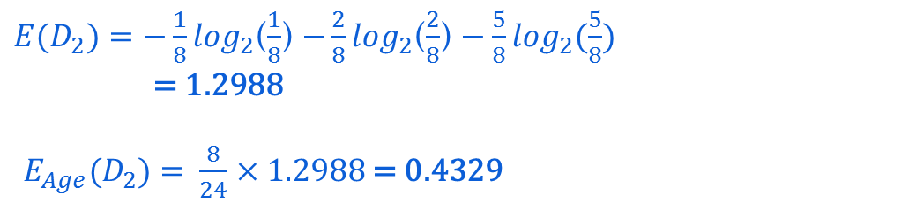
Calculating Information Gain
Training set: $D_{2}$(Age = 2)
Age | Eye-sight | Astigmatism | Use type | Class
2 | 1 | 1 | 1 | 3
2 | 1 | 1 | 2 | 2
2 | 1 | 2 | 1 | 3
2 | 1 | 2 | 2 | 1
2 | 2 | 1 | 1 | 3
2 | 2 | 1 | 2 | 2
2 | 2 | 2 | 1 | 3
2 | 2 | 2 | 2 | 3
${E(D}_{2})=−\frac{1}{8}\log_{2}$($\frac{1}{8}$) $−\frac{2}{8}\log_{2}$($\frac{2}{8}$) $−$ $\frac{5}{8}\log_{2}$($\frac{5}{8}$)
= 1.2988
$E_{Age}{(D}_{2})=$ $\frac{8}{24}$ × 1.2988 = 0.4329

Slide 64
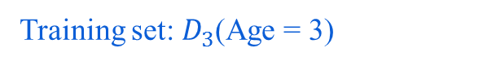
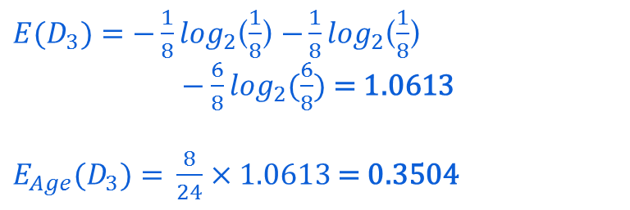
Calculating Information Gain
Training set: $D_{3}$(Age = 3)
Age | Eye-sight | Astigmatism | Use type | Class
3 | 1 | 1 | 1 | 3
3 | 1 | 1 | 2 | 3
3 | 1 | 2 | 1 | 3
3 | 1 | 2 | 2 | 1
3 | 2 | 1 | 1 | 3
3 | 2 | 1 | 2 | 2
3 | 2 | 2 | 1 | 3
3 | 2 | 2 | 2 | 3
${E(D}_{3})=−\frac{1}{8}\log_{2}$($\frac{1}{8}$) $−\frac{1}{8}\log_{2}$($\frac{1}{8}$)
$−$ $\frac{6}{8}\log_{2}$($\frac{6}{8}$) = 1.0613
$E_{Age}{(D}_{3})=$ $\frac{8}{24}$ × 1.0613 = 0.3504
$α (Age, D)$ = 1.3261 – (0.5000 + 0.4329 + 0.3504) = 0.0394

Slide 65
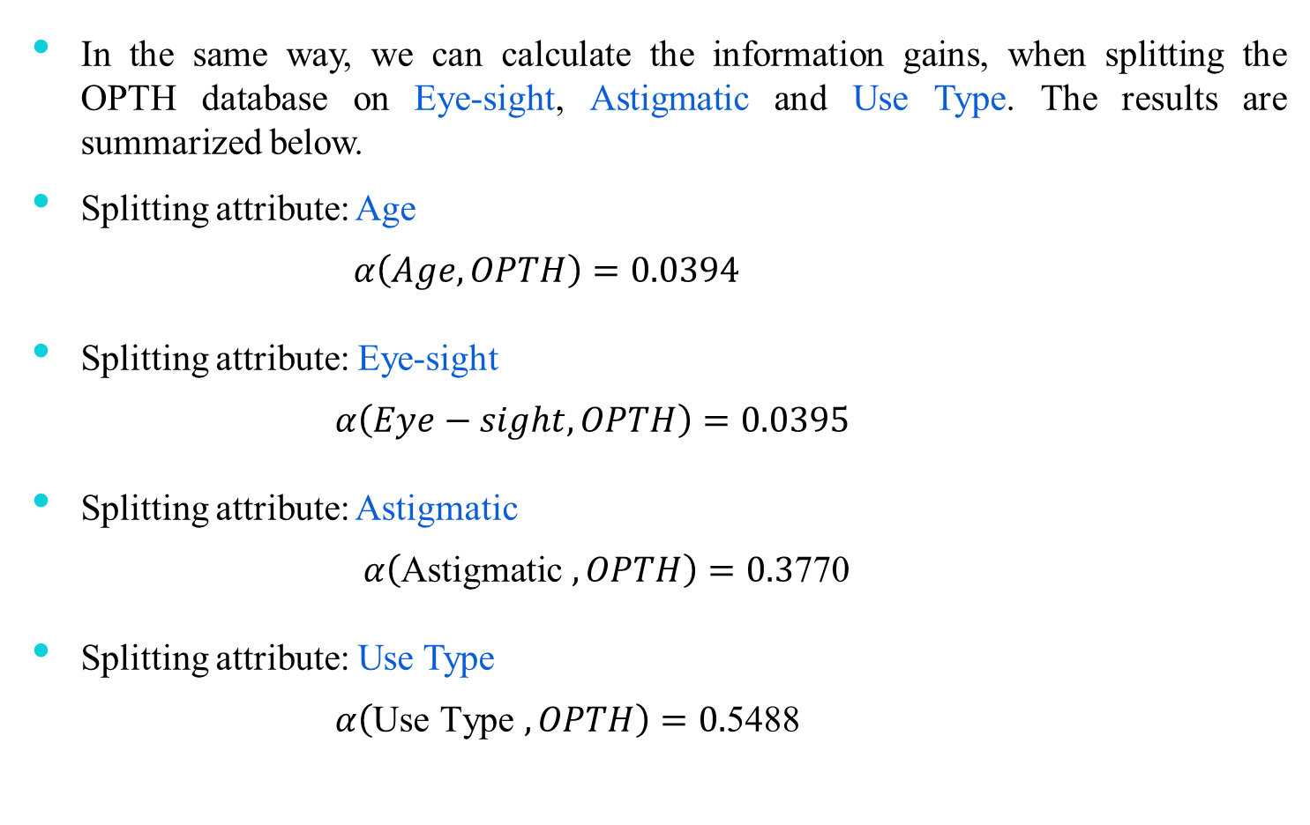
Information Gains for Different Attributes
In the same way, we can calculate the information gains, when splitting the OPTH database on Eye-sight, Astigmatic and Use Type. The results are summarized below.
Splitting attribute: Age
$$α\left(Age, OPTH\right)=0.0394$$
Splitting attribute: Eye-sight
$α\left(Eye−sight, OPTH\right)=0.0395$
Splitting attribute: Astigmatic
$α\left(\text{Astigmatic} , OPTH\right)=0.3$770
Splitting attribute: Use Type
$α\left(\text{Use} \text{Type} , OPTH\right)=0.$5488

Slide 66
Illustrative Training Set

Slide 67
Algorithm CART

Slide 68
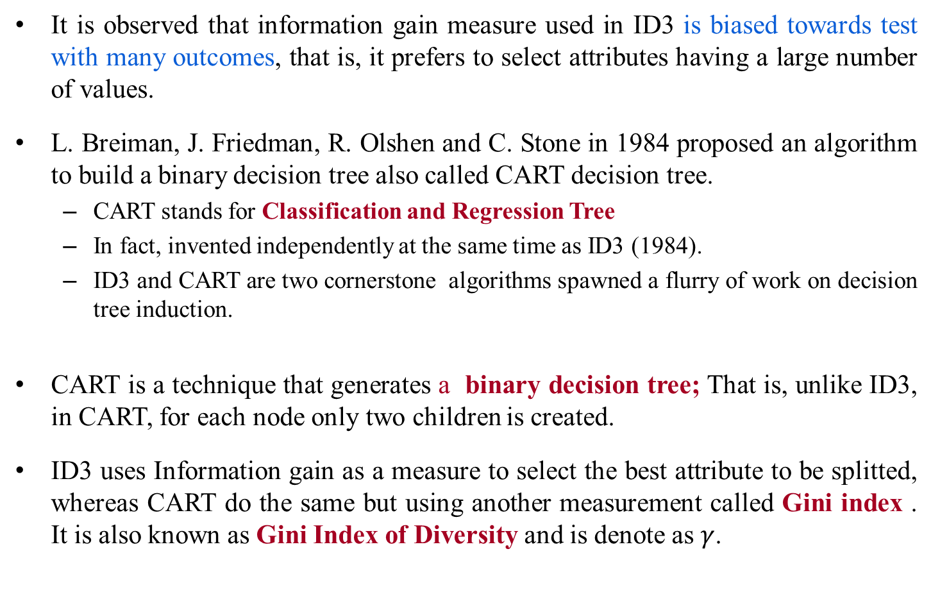
CART Algorithm
It is observed that information gain measure used in ID3 is biased towards test with many outcomes, that is, it prefers to select attributes having a large number of values.
L. Breiman, J. Friedman, R. Olshen and C. Stone in 1984 proposed an algorithm to build a binary decision tree also called CART decision tree.
CART stands for Classification and Regression Tree
In fact, invented independently at the same time as ID3 (1984).
ID3 and CART are two cornerstone algorithms spawned a flurry of work on decision tree induction.
CART is a technique that generates a binary decision tree; That is, unlike ID3, in CART, for each node only two children is created.
ID3 uses Information gain as a measure to select the best attribute to be splitted, whereas CART do the same but using another measurement called Gini index . It is also known as Gini Index of Diversity and is denote as $γ$.

Slide 69
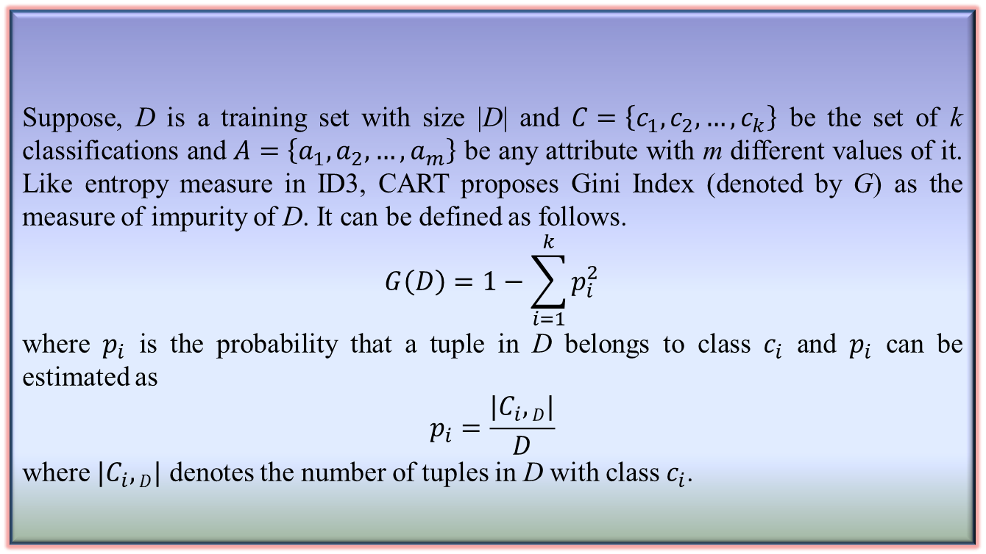
Gini Index of Diversity
Suppose, D is a training set with size |D| and $C=\left\{c_{1},c_{2},…,c_{k}\right\}$ be the set of k classifications and $A=\left\{a_{1},a_{2},…,a_{m}\right\}$ be any attribute with m different values of it. Like entropy measure in ID3, CART proposes Gini Index (denoted by G) as the measure of impurity of D. It can be defined as follows.
$$G\left(D\right)=1−\sum_{i=1}^{k}{p_{i}^{2}}$$
where $p_{i}$ is the probability that a tuple in D belongs to class $c_{i}$ and $p_{i}$ can be estimated as
$$p_{i}=\frac{|C_{i},D|}{D}$$
where $|C_{i},D|$ denotes the number of tuples in D with class $c_{i}$.
Definition 9.6: Gini Index

Slide 70
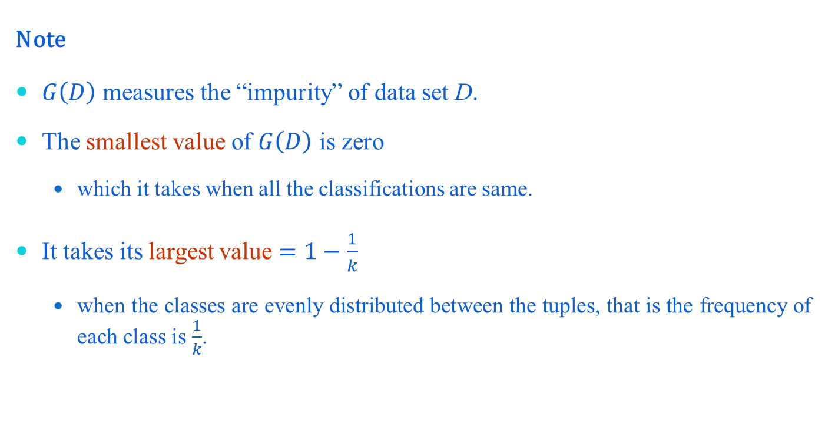
Gini Index of Diversity
Note
$G\left(D\right)$ measures the “impurity” of data set D.
The smallest value of $G\left(D\right)$ is zero
which it takes when all the classifications are same.
It takes its largest value $=1−\frac{1}{k}$
when the classes are evenly distributed between the tuples, that is the frequency of each class is $\frac{1}{k}$.

Slide 71
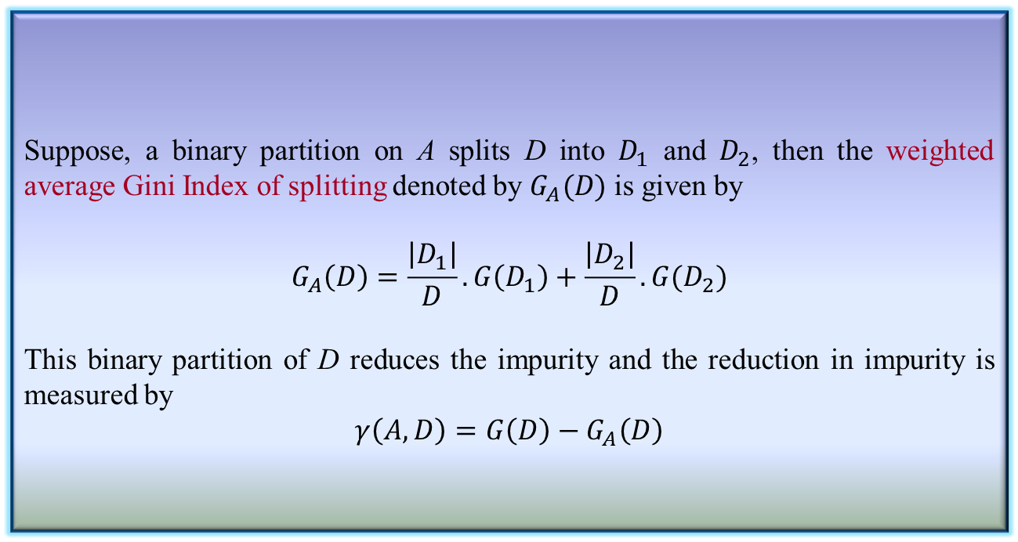
Gini Index of Diversity
Suppose, a binary partition on A splits D into $D_{1}$ and $D_{2}$, then the weighted average Gini Index of splitting denoted by $G_{A}(D)$ is given by
$$G_{A}\left(D\right)=\frac{\left|D_{1}\right|}{D}.G\left(D_{1}\right)+\frac{\left|D_{2}\right|}{D}.G(D_{2})$$
This binary partition of D reduces the impurity and the reduction in impurity is measured by
$$γ\left(A,D\right)=G\left(D\right)−G_{A}\left(D\right)$$
Definition 9.7: Gini Index of Diversity

Slide 72
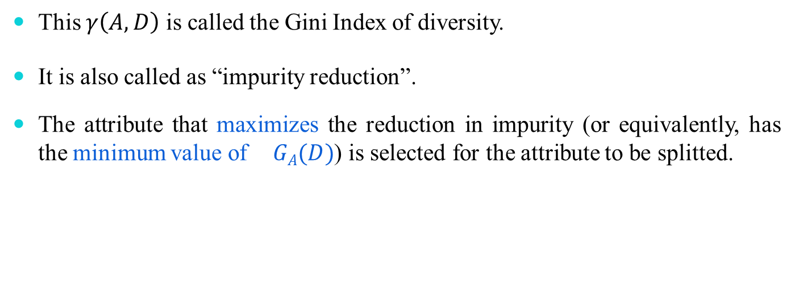
Gini Index of Diversity and CART
This $γ\left(A,D\right)$ is called the Gini Index of diversity.
It is also called as “impurity reduction”.
The attribute that maximizes the reduction in impurity (or equivalently, has the minimum value of$GA(D)$) is selected for the attribute to be splitted.

Slide 73
CART Algorithm : Illustration
Example 9.15 : CART Algorithm
Suppose we want to build decision tree for the data set EMP as given in the table below.
Age
Y : young
M : middle-aged
O : old
Salary
L : low
M : medium
H : high
Job
G : government
P : private
Performance
A : Average
E : Excellent
Class : Select
Y : yes
N : no
Tuple# | Age | Salary | Job | Performance | Select
1 | Y | H | P | A | N
2 | Y | H | P | E | N
3 | M | H | P | A | Y
4 | O | M | P | A | Y
5 | O | L | G | A | Y
6 | O | L | G | E | N
7 | M | L | G | E | Y
8 | Y | M | P | A | N
9 | Y | L | G | A | Y
10 | O | M | G | A | Y
11 | Y | M | G | E | Y
12 | M | M | P | E | Y
13 | M | H | G | A | Y
14 | O | M | P | E | N

Slide 74
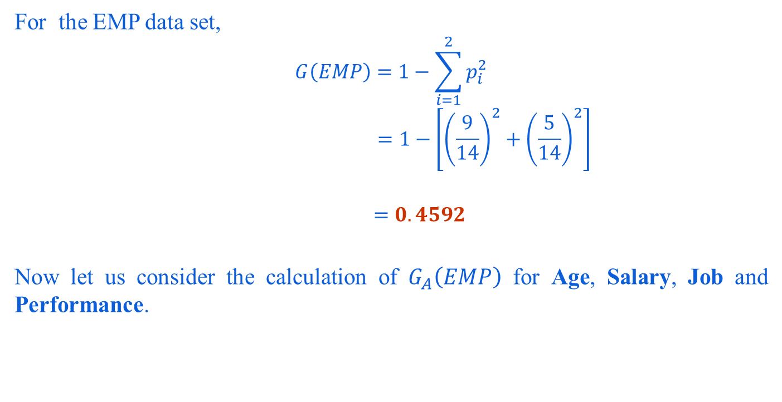
CART Algorithm : Illustration
For the EMP data set,
$$G\left(EMP\right)=1−\sum_{i=1}^{2}{p_{i}^{2}}$$
$$=1−\left[{\left(\frac{9}{14}\right)}^{2}+{\left(\frac{5}{14}\right)}^{2}\right]$$
$$=0.4592$$
Now let us consider the calculation of $G_{A}\left(EMP\right)$ for Age, Salary, Job and Performance.

Slide 75
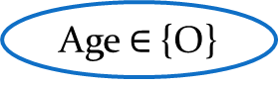
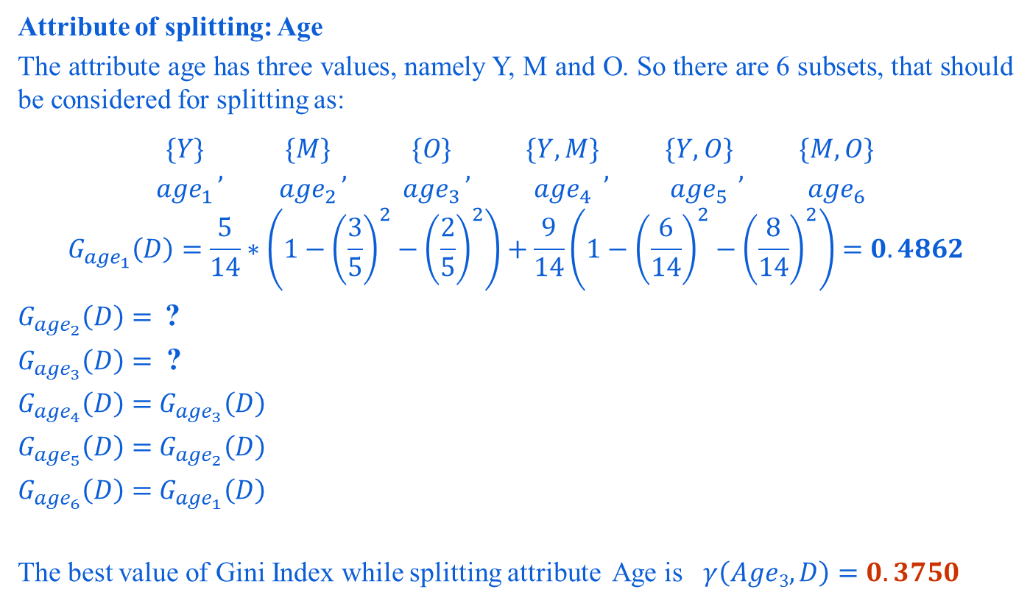
CART Algorithm : Illustration
Attribute of splitting: Age
The attribute age has three values, namely Y, M and O. So there are 6 subsets, that should be considered for splitting as:
$${\{Y\} \atop {age}_{1}}, {\{M\} \atop {age}_{2}}, {\{O\} \atop {age}_{3}}, {\{Y,M\} \atop {age}_{4}}, {\{Y,O\} \atop {age}_{5}}, {\{M,O\} \atop {age}_{6}}$$
$$G_{{age}_{1}}\left(D\right)=\frac{5}{14}∗\left(1−{\left(\frac{3}{5}\right)}^{2}−{\left(\frac{2}{5}\right)}^{2}\right)+\frac{9}{14}\left(1−{\left(\frac{6}{14}\right)}^{2}−{\left(\frac{8}{14}\right)}^{2}\right)=0.4862$$
$G_{{age}_{2}}\left(D\right)=$ ?
$G_{{age}_{3}}\left(D\right)=$ ?
$G_{{age}_{4}}\left(D\right)=$ $G_{{age}_{3}}\left(D\right)$
$G_{{age}_{5}}\left(D\right)=$ $G_{{age}_{2}}\left(D\right)$
$G_{{age}_{6}}\left(D\right)=$ $G_{{age}_{1}}\left(D\right)$
The best value of Gini Index while splitting attribute Age is $γ\left(Age3,D\right)=0.3750$
Age $∈${O}
Yes
No
{O} {Y,M}

Slide 76

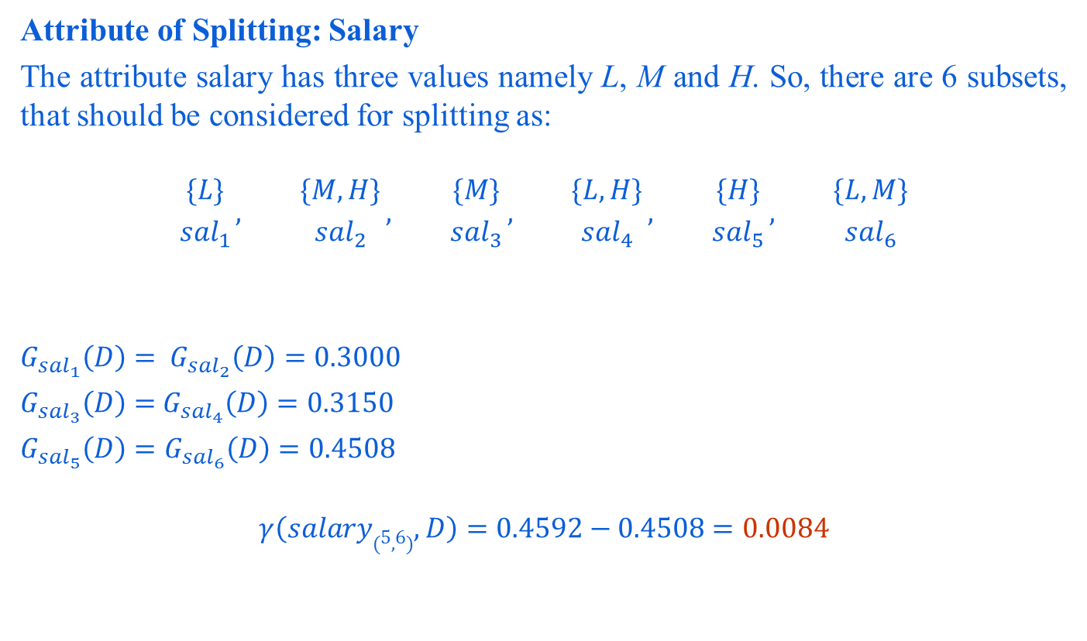
CART Algorithm : Illustration
Attribute of Splitting: Salary
The attribute salary has three values namely L, M and H. So, there are 6 subsets, that should be considered for splitting as:
$${\{L\} \atop {sal}_{1}}, {\{M,H\} \atop {sal}_{2}}, {\{M\} \atop {sal}_{3}}, {\{L,H\} \atop {sal}_{4}}, {\{H\} \atop {sal}_{5}}, {\{L,M\} \atop {sal}_{6}}$$
$G_{{sal}_{1}}\left(D\right)=$ $G_{{sal}_{2}}\left(D\right)=0.3000$
$G_{{sal}_{3}}\left(D\right)=$ $G_{{sal}_{4}}\left(D\right)=0.3150$
$G_{{sal}_{5}}\left(D\right)=G_{{sal}_{6}}\left(D\right)=0.4508$
$$γ\left(salary(5,6),D\right)=0.4592−0.4508=0.0084$$
Salary $∈${H}
Yes
No
{H} {L,M}

Slide 77
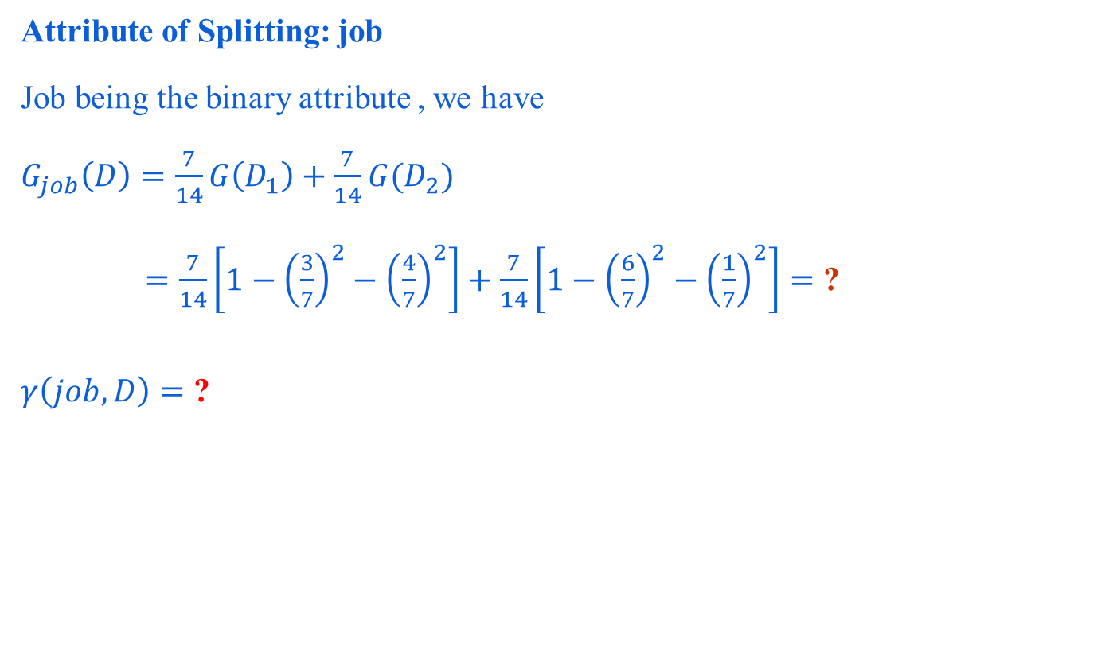
CART Algorithm : Illustration
Attribute of Splitting: job
Job being the binary attribute , we have
$G_{job}\left(D\right)=\frac{7}{14}G\left(D_{1}\right)+\frac{7}{14}G(D_{2})$
$=\frac{7}{14}\left[1−{\left(\frac{3}{7}\right)}^{2}−{\left(\frac{4}{7}\right)}^{2}\right]+\frac{7}{14}\left[1−{\left(\frac{6}{7}\right)}^{2}−{\left(\frac{1}{7}\right)}^{2}\right]=$ ?
$γ\left(job,D\right)=$ ?

Slide 78
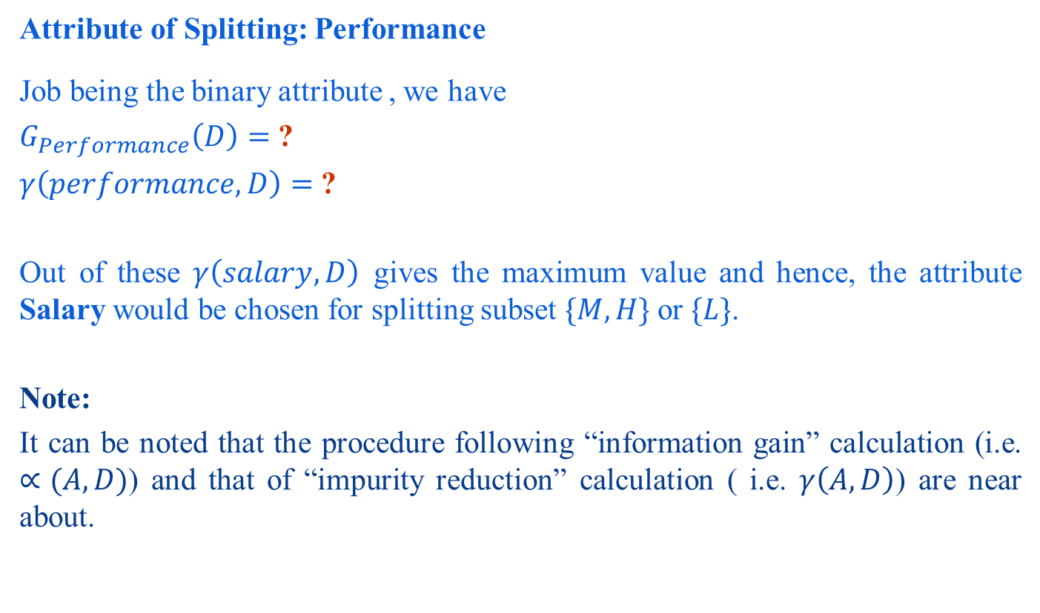
CART Algorithm : Illustration
Attribute of Splitting: Performance
Job being the binary attribute , we have
$G_{Performance}\left(D\right)=$ ?
$γ\left(performance,D\right)=$ ?
Out of these $γ\left(salary,D\right)$ gives the maximum value and hence, the attribute Salary would be chosen for splitting subset $\{M, H\}$or $\{L\}$.
Note:
It can be noted that the procedure following “information gain” calculation (i.e. $∝(A,D)$) and that of “impurity reduction” calculation ( i.e. $γ\left(A,D\right)$) are near about.

Slide 79
Decision Trees with ID3 and CART Algorithms
Example 9.17 : Comparing Decision Trees of EMP Data set
Compare two decision trees obtained using ID3 and CART for the EMP dataset. The decision tree according to ID3 is given for your ready reference (subject to the verification)
Decision Tree using ID3
?
Decision Tree using CART
Y
Age
O
Job
Y
Performance
P
G
A
E
N
Y
Y
N

Slide 80
Algorithm C4.5

Slide 81
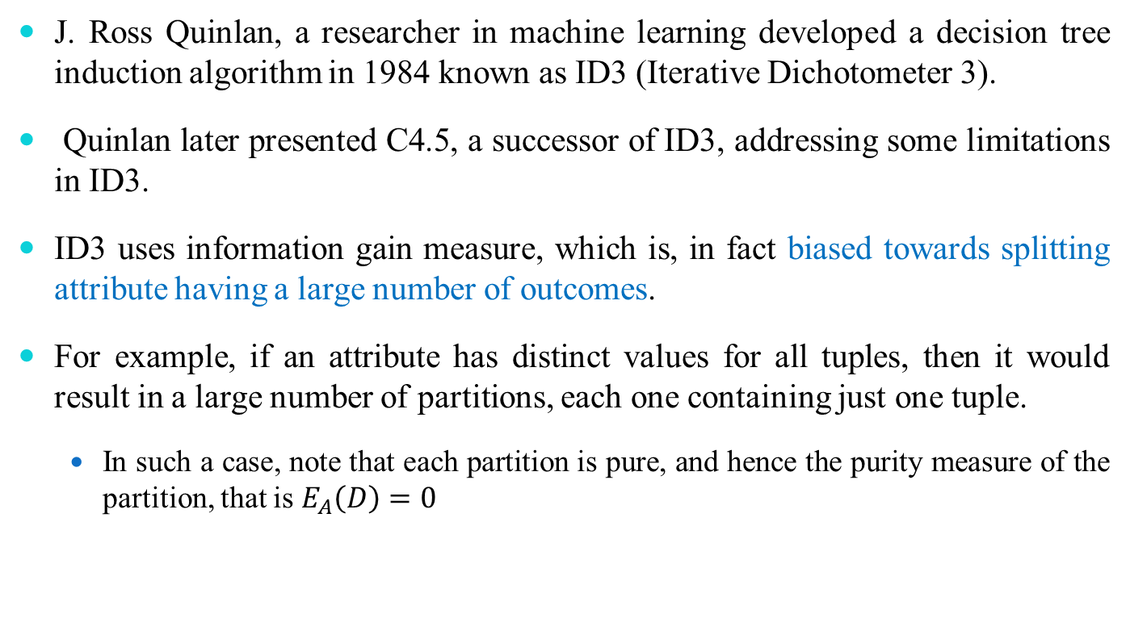
Algorithm C 4.5 : Introduction
J. Ross Quinlan, a researcher in machine learning developed a decision tree induction algorithm in 1984 known as ID3 (Iterative Dichotometer 3).
Quinlan later presented C4.5, a successor of ID3, addressing some limitations in ID3.
ID3 uses information gain measure, which is, in fact biased towards splitting attribute having a large number of outcomes.
For example, if an attribute has distinct values for all tuples, then it would result in a large number of partitions, each one containing just one tuple.
In such a case, note that each partition is pure, and hence the purity measure of the partition, that is $E_{A}\left(D\right)=0$

Slide 82
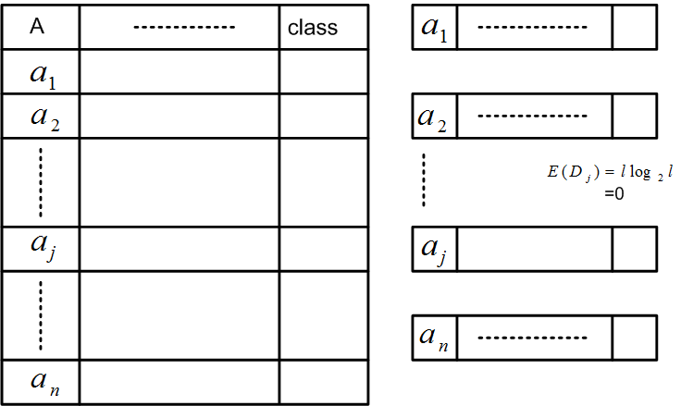
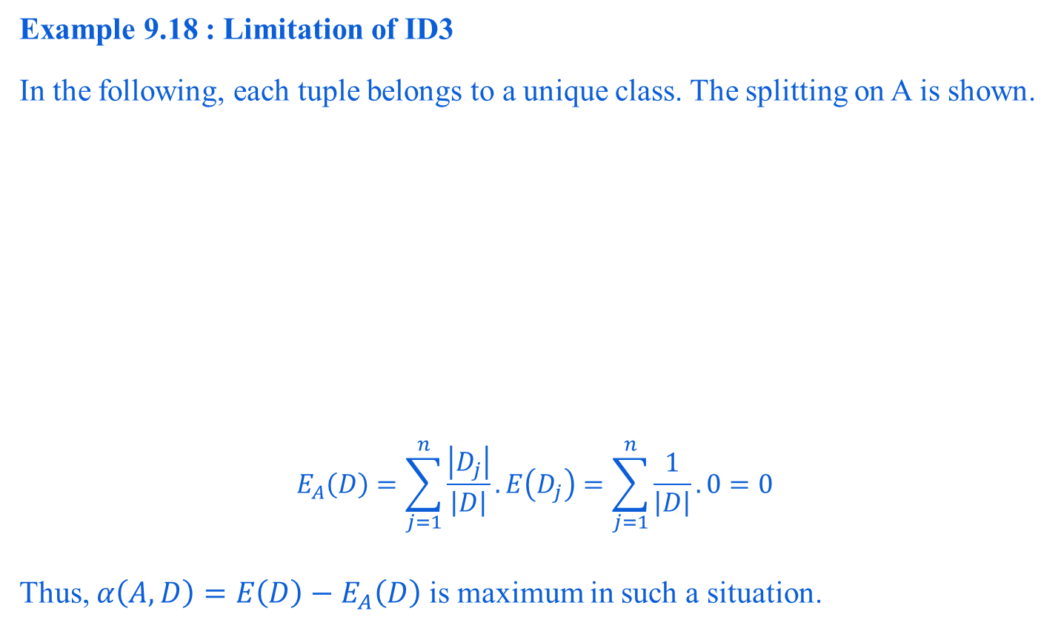
Algorithm C4.5 : Introduction
Example 9.18 : Limitation of ID3
In the following, each tuple belongs to a unique class. The splitting on A is shown.
$$E_{A}\left(D\right)=\sum_{j=1}^{n}{\frac{\left|D_{j}\right|}{\left|D\right|}.E\left(D_{j}\right)=\sum_{j=1}^{n}{\frac{1}{\left|D\right|}. 0=0}}$$
Thus, $α\left(A,D\right)=E\left(D\right)−E_{A}\left(D\right)$ is maximum in such a situation.

Slide 83
Algorithm: C 4.5 : Introduction
Although, the previous situation is an extreme case, intuitively, we can infer that ID3 favours splitting attributes having a large number of values
compared to other attributes, which have a less variations in their values.
Such a partition appears to be useless for classification.
This type of problem is called overfitting problem.
Note:
Decision Tree Induction Algorithm ID3 may suffer from overfitting problem.

Slide 84
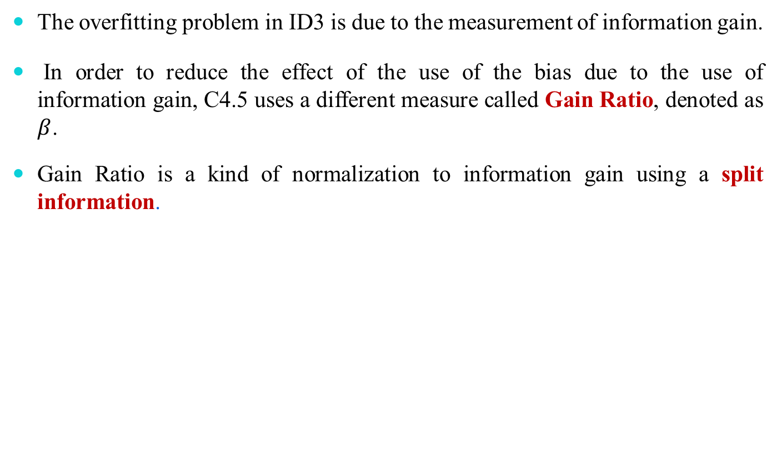
Algorithm: C 4.5 : Introduction
The overfitting problem in ID3 is due to the measurement of information gain.
In order to reduce the effect of the use of the bias due to the use of information gain, C4.5 uses a different measure called Gain Ratio, denoted as $β$.
Gain Ratio is a kind of normalization to information gain using a split information.

Slide 85
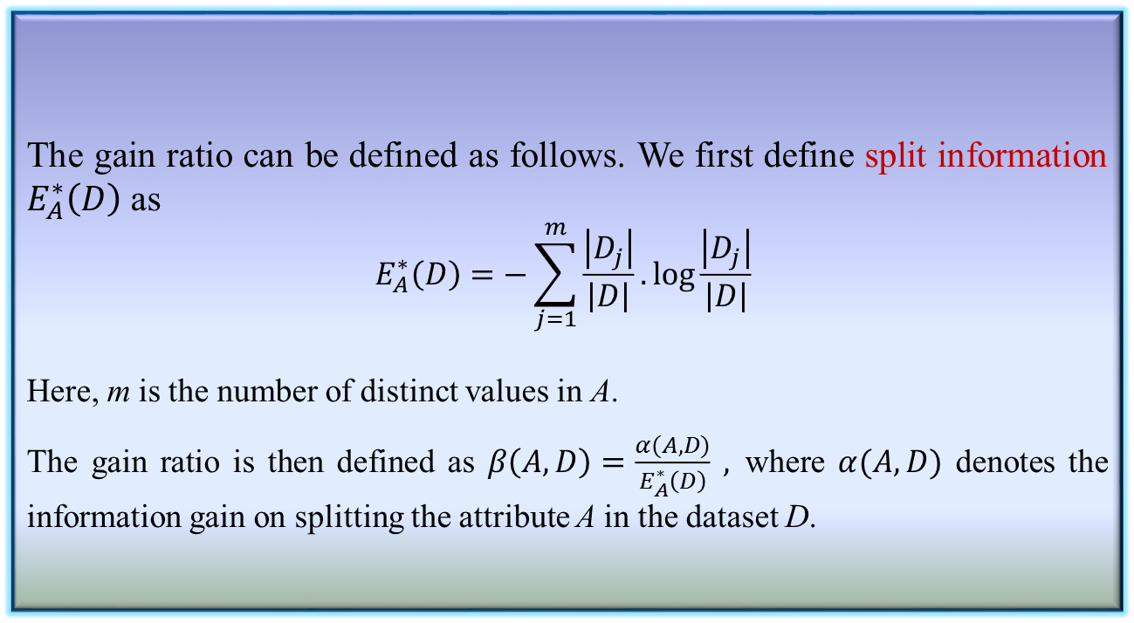
Algorithm: C 4.5 : Gain Ratio
The gain ratio can be defined as follows. We first define split information $E_{A}^{∗}\left(D\right)$ as
$$E_{A}^{∗}\left(D\right)=−\sum_{j=1}^{m}{\frac{\left|D_{j}\right|}{\left|D\right|}.\log{\frac{\left|D_{j}\right|}{\left|D\right|}} }$$
Here, m is the number of distinct values in A.
The gain ratio is then defined as $β\left(A,D\right)=\frac{α(A,D)}{E_{A}^{∗}\left(D\right)} ,$where $α(A,D)$ denotes the information gain on splitting the attribute A in the dataset D.
Definition 9.8: Gain Ratio

Slide 86
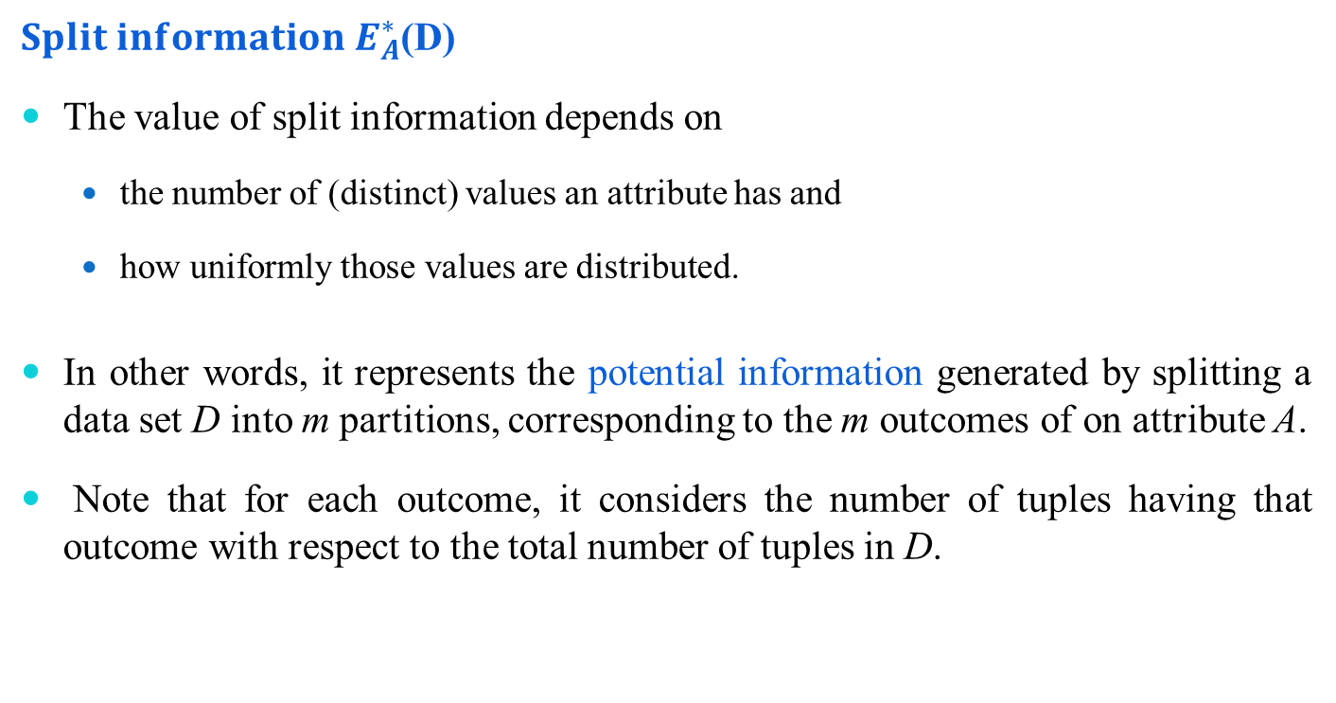
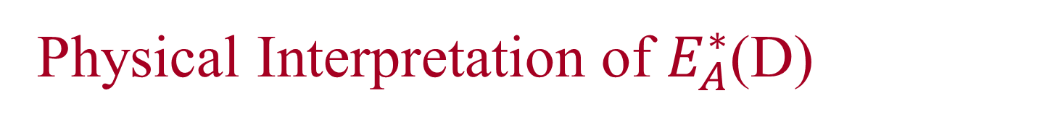
Physical Interpretation of $E_{A}^{∗}$(D)
$Split$ $information$ $E_{A}^{∗}$(D)
The value of split information depends on
the number of (distinct) values an attribute has and
how uniformly those values are distributed.
In other words, it represents the potential information generated by splitting a data set D into m partitions, corresponding to the m outcomes of on attribute A.
Note that for each outcome, it considers the number of tuples having that outcome with respect to the total number of tuples in D.

Slide 87
Summary of Decision Tree Induction Algorithms
We have learned the building of a decision tree given a training data.
The decision tree is then used to classify a test data.
For a given training data D, the important task is to build the decision tree so that:
All test data can be classified accurately
The tree is balanced and with as minimum depth as possible, thus the classification can be done at a faster rate.
In order to build a decision tree, several algorithms have been proposed. These algorithms differ from the chosen splitting criteria, so that they satisfy the above mentioned objectives as well as the decision tree can be induced with minimum time complexity. We have studied three decision tree induction algorithms namely ID3, CART and C4.5. A summary of these three algorithms is presented in the following table.

Slide 88
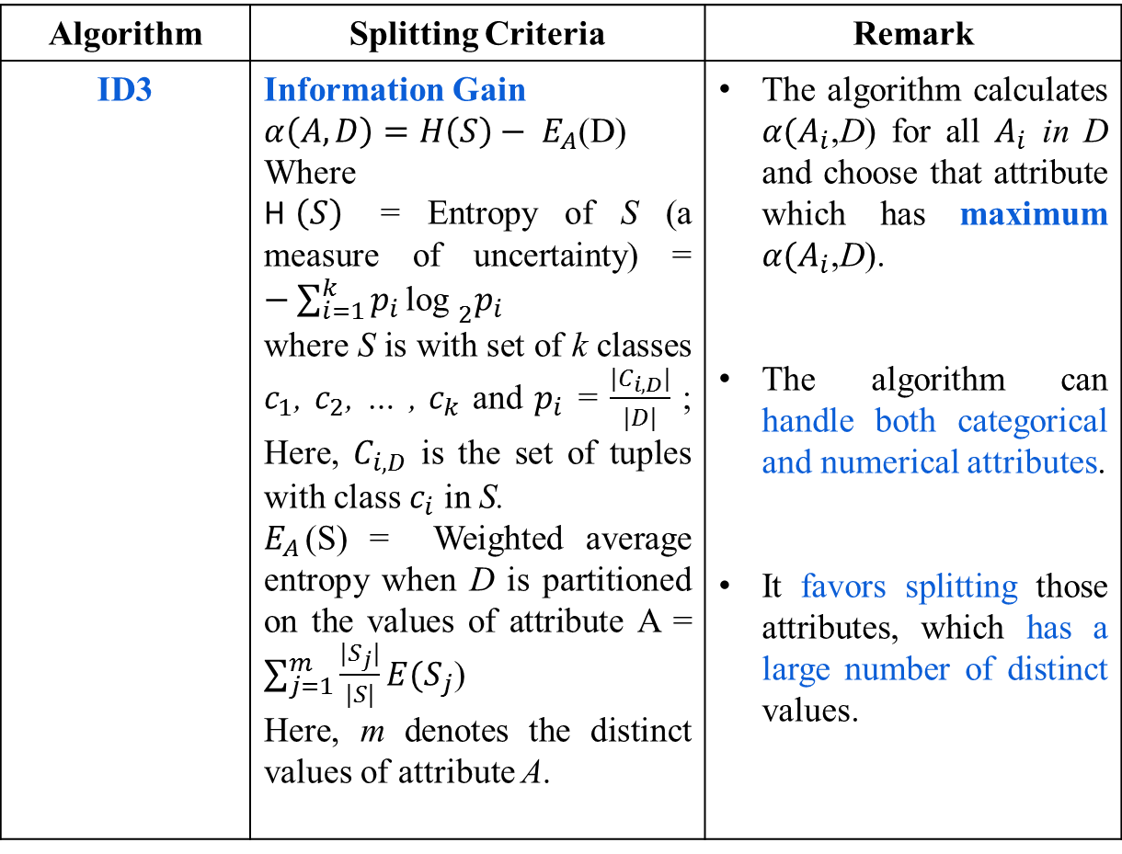
Table 11.6
Algorithm | Splitting Criteria | Remark
ID3 | Information Gain $α\left(A,D\right)=H\left(S\right)− E_{A}$(D) Where H$\left(S\right)$ = Entropy of S (a measure of uncertainty) = $−\sum_{i=1}^{k}{p_{i}}{\text{log} }_{2}p_{i}$ where S is with set of k classes $c_{1}$, $c_{2}$, … , $c_{k}$ and $p_{i}$ = $\frac{|C_{i,D}|}{|D|}$ ; Here, $C_{i,D}$ is the set of tuples with class $c_{i}$ in S. $E_{A}$(S) = Weighted average entropy when D is partitioned on the values of attribute A = $\sum_{j=1}^{m}{\frac{|S_{j}|}{|S|}}E{(S}_{j}$) Here, m denotes the distinct values of attribute A. | The algorithm calculates $α{(A}_{i}$,D) for all $A_{i}$ in D and choose that attribute which has maximum $α{(A}_{i}$,D). The algorithm can handle both categorical and numerical attributes. It favors splitting those attributes, which has a large number of distinct values.

Slide 89

Algorithm | Splitting Criteria | Remark
CART | Gini Index $γ\left(A,D\right)=G\left(D\right)− G_{A}$(D) where $G\left(D\right)$ = Gini index (a measure of impurity) = $1−\sum_{i=1}^{k}{{p_{i}}^{2}}$ Here, $p_{i}$ = $\frac{|C_{i,D}|}{|D|}$ and D is with k number of classes $and$ G_{A}(D) = $\frac{|D_{1}|}{|D|}G{(D}_{1}$) + $\frac{|D_{2}|}{|D|}G{(D}_{2}$), when D is partitioned into two data sets $D_{1}$ and $D_{2}$ based on some values of attribute A. | The algorithm calculates all binary partitions for all possible values of attribute A and choose that binary partition which has the maximum $γ\left(A,D\right).$ The algorithm is computationally very expensive when the attribute A has a large number of values.

Slide 90

Algorithm | Splitting Criteria | Remark
C4.5 | Gain Ratio $$β\left(A,D\right)=\frac{α\left(A,D\right)}{E_{A}^{∗}\text{(}\text{D}\text{)}}$$ where $α\left(A,D\right)$ = Information gain of D (same as in ID3, and $E_{A}^{∗}\text{(}\text{D}\text{)}$ = splitting information = $−\sum_{j=1}^{m}{\frac{|D_{j}|}{|D|}}\log_{2}\frac{|D_{j}|}{|D|}$ when D is partitioned into $D_{1}$, $D_{2}$, … , $D_{m}$ partitions corresponding to m distinct attribute values of A. | The attribute A with maximum value of $β\left(A,D\right)$ is selected for splitting. Splitting information is a kind of normalization, so that it can check the biasness of information gain towards the choosing attributes with a large number of distinct values.
In addition to this, we also highlight few important characteristics of decision tree induction algorithms in the following.

Slide 91
Notes on Decision Tree Induction algorithms
Optimal Decision Tree: Finding an optimal decision tree is an NP-complete problem. Hence, decision tree induction algorithms employ a heuristic based approach to search for the best in a large search space. Majority of the algorithms follow a greedy, top-down recursive divide-and-conquer strategy to build decision trees.
Missing data and noise: Decision tree induction algorithms are quite robust to the data set with missing values and presence of noise. However, proper data pre-processing can be followed to nullify these discrepancies.
Redundant Attributes: The presence of redundant attributes does not adversely affect the accuracy of decision trees. It is observed that if an attribute is chosen for splitting, then another attribute which is redundant is unlikely to chosen for splitting.
Computational complexity: Decision tree induction algorithms are computationally inexpensive, in particular, when the sizes of training sets are large, Moreover, once a decision tree is known, classifying a test record is extremely fast, with a worst-case time complexity of O(d), where d is the maximum depth of the tree.

Slide 92
Notes on Decision Tree Induction algorithms
Data Fragmentation Problem: Since the decision tree induction algorithms employ a top-down, recursive partitioning approach, the number of tuples becomes smaller as we traverse down the tree. At a time, the number of tuples may be too small to make a decision about the class representation, such a problem is known as the data fragmentation. To deal with this problem, further splitting can be stopped when the number of records falls below a certain threshold.
Tree Pruning: A sub-tree can replicate two or more times in a decision tree (see figure below). This makes a decision tree unambiguous to classify a test record. To avoid such a sub-tree replication problem, all sub-trees except one can be pruned from the tree.
A
C
B
D
1
0
C
0
1
D
1
0
1

Slide 93


Notes on Decision Tree Induction algorithms
Decision tree equivalence: The different splitting criteria followed in different decision tree induction algorithms have little effect on the performance of the algorithms. This is because the different heuristic measures (such as information gain ($α$), Gini index ($γ$) and Gain ratio ($β$) are quite consistent with each other); also see the figure below.

Slide 94
Reference
The detail material related to this lecture can be found in
Data Mining: Concepts and Techniques, (3rd Edn.), Jiawei Han, Micheline Kamber, Morgan Kaufmann, 2015.
Introduction to Data Mining, Pang-Ning Tan, Michael Steinbach, and Vipin Kumar, Addison-Wesley, 2014

Slide 95
Any question?
You may post your question(s) at the “Discussion Forum” maintained in the course Web page!

